Slide 1
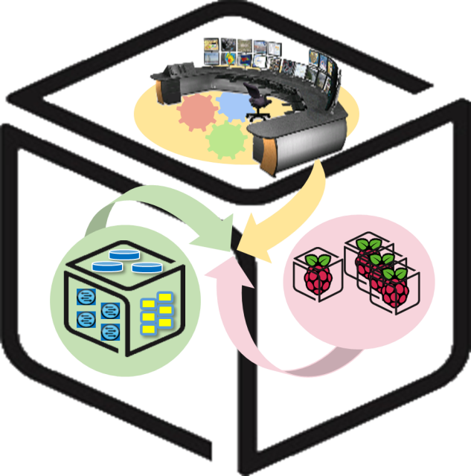
SmartX Labs for computer systems
WebApp Lab
version 1.0

Slide 2
History and Contributor of Box Lab
(2017. 05. 11)
Version | Updated Date | Updated Contents | Contributor
 |  |  | Lucas
V1.0 | 2016-05-22 |  | 이준기
V1.1 | 2017-05-10 | 실습자료 업데이트 | 권진철

Slide 3


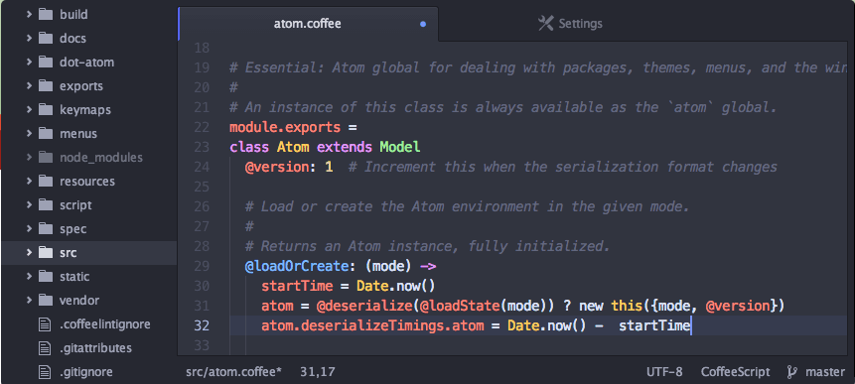
Atom Editor : Free and open-source source code editor
Cross-Platform
Atom works across operation systems. (OS X, Windows, Linux)
Built-in package manager
Search for and install new packages which allows you to make your custom dev. environment.
Smart auto-completion
Helps you write code faster with autocomplete.

Slide 4
Atom Editor : Installation and Execution
How to Install Atom
1. Download installer file (deb) https://github.com/atom/atom/releases/download/v1.16.0/atom-amd64.deb
2. Execute the installer
How to use
1. On CLI
sudo atom {directory}
Ex) sudo atom .
2. On GUI
Double Click Atom icon

Slide 5
웹 서버 프로그래밍
Node.js 이전 (e.g LAMP)
Node.js 사용
Web Browser
Web
Server
(Daemon/
Service)
Server-side Script
(JSP, PHP, ASP, …)
Database
Web Browser
Web Browser
Web Browser
Client-side Script
(Java Script)
Client-side Script
(Java Script)
Client-side Script
(Java Script)
Client-side Script
(Java Script)
Web Browser
Server-side JavaScript
(Node.js)
Database
Web Browser
Web Browser
Web Browser
Client-side Script
(Java Script)
Client-side Script
(Java Script)
Client-side Script
(Java Script)
Client-side Script
(Java Script)

Slide 6
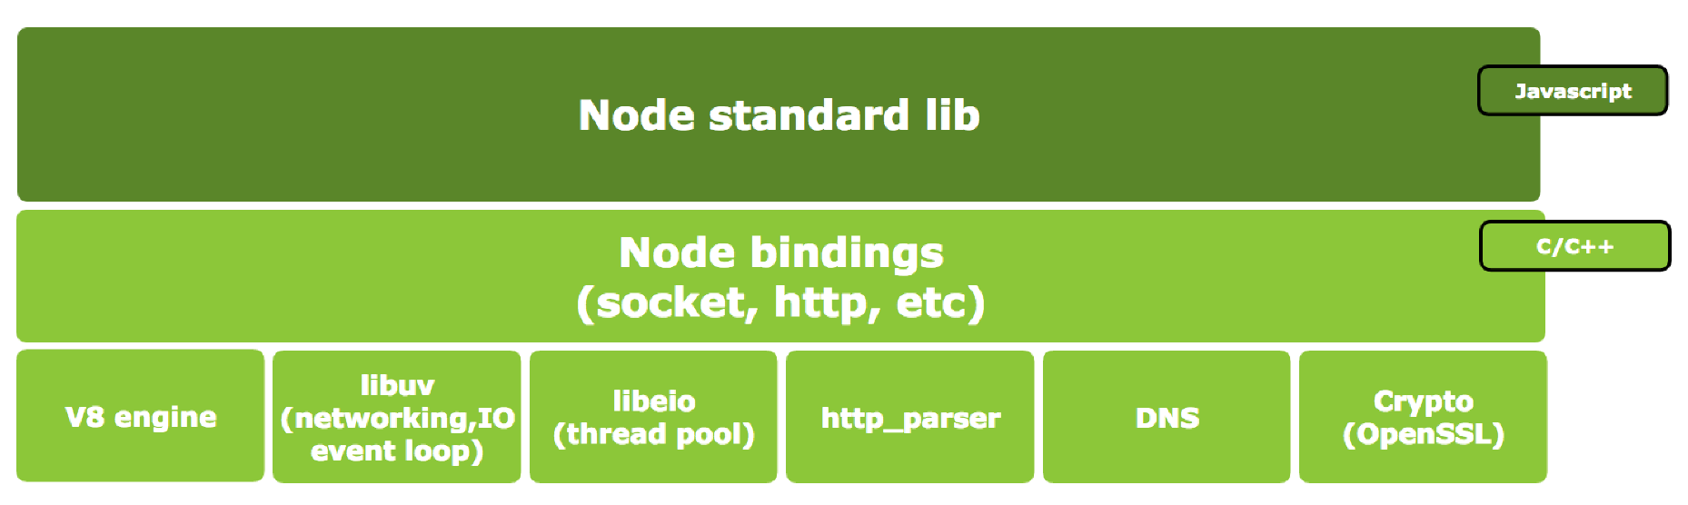
Node.js Architecture

Slide 7
Node.js Pros and Cons
Pros
Server-side JavaScript → 높은 생산성
Single thread, non-block I/O → 가볍고 빠름
I/O 직접수행 안 함 → 프로세스 Block되지 않음
Cons
Single thread → 멀티코어 CPU 효율을 위해 여러 개의 프로세스를 사용해야 하고, 어떤 한 작업이 무거우면 전체 성능이 저하될 수 있음
Event Callback → 중첩될 경우 소스코드의 가독성 급격히 저하 (callback hell)
V8 engine → Garbage Collection기반 메모리관리로 순간적인 CPU 사용률 상승 가능성 있고, 이는 서버 안정성 저하

Slide 8
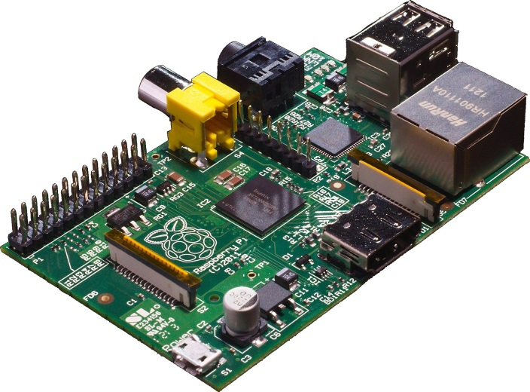
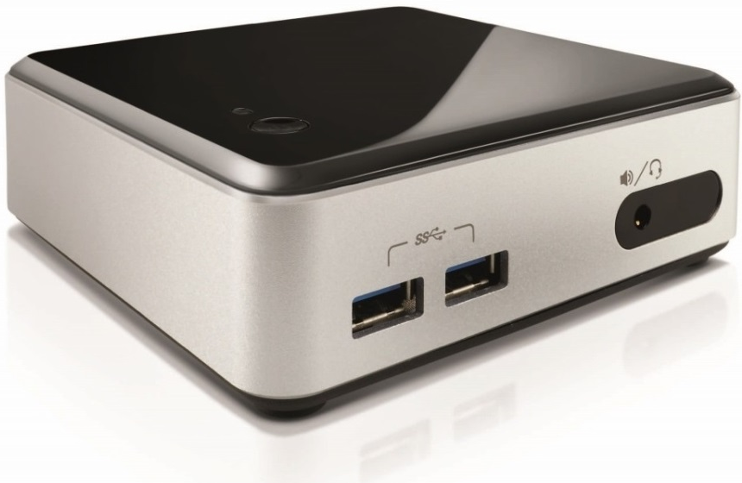
개발환경 구축
Install Node.js on NUC (Ubuntu 16.04)
$ sudo apt-get update
$ sudo apt-get install nodejs npm
OS: Hypriot 1.4.0
OS: Ubuntu 16.04
Web-Server: Node.js
HTTP Request
HTTP Response
<Web Client>
<Web Server>

Slide 9
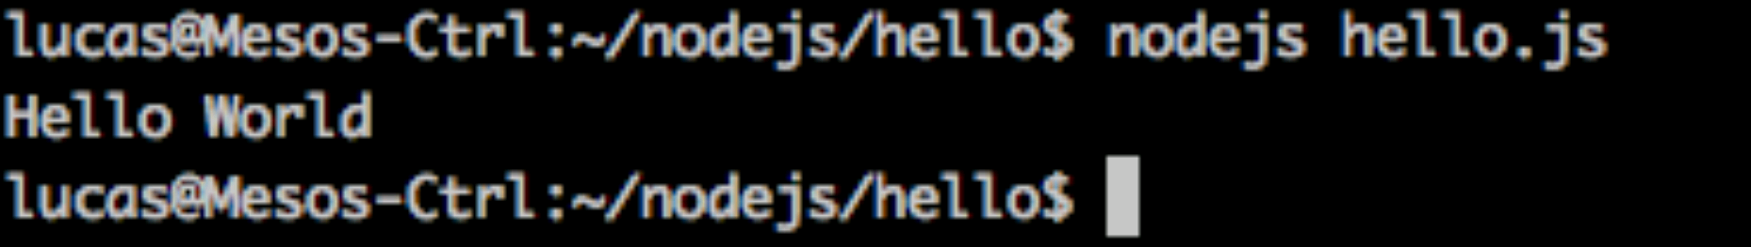
Test Your environment
Make a test code
$ vim hello.js
How to run?
$ nodejs hello.js
console.log('Hello World');

Slide 10
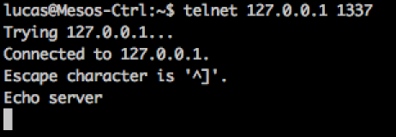
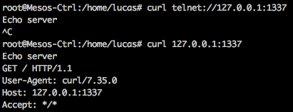
Example2: Simple TCP Server
var net = require('net');
var server = net.createServer(function (socket) {
socket.write('Echo server\r\n');
socket.pipe(socket);
});
server.listen(1337);
<Client>

Slide 11


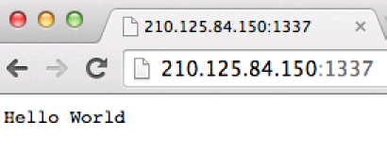
Example3: Simple Web Server
var http = require('http');
http.createServer(function (req, res) {
res.writeHead(200, {'Content-Type': 'text/plain'});
res.end('Hello World\n');
}).listen(1337);
console.log('Server running at port 1337/');
<Server>
<Client>

Slide 12
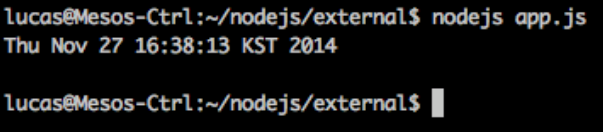
Example4: External File Execution (Simple)
var exec = require('child_process').exec;
exec("date", function (error, stdout, stderr) {
console.log(stdout);
});

Slide 13
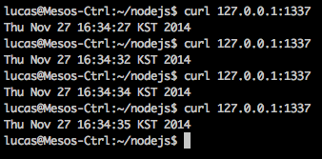
Example5: External File Execution (Web)
var http = require('http'),
exec = require('child_process').exec;
http.createServer(function (req, res) {
res.writeHead(200, {'Content-Type': 'text/plain'});
exec("date", function (error, stdout, stderr) {res.end(stdout)} );
}).listen(1337);
console.log('Server running');

Slide 14
Node Packaged Module(NPM)
Node.js로 만들어진 모듈 관리자
Ubuntu의 APT와 유사하다
패키지 설치
npm install <package name>
Global install: 패키지를 /usr/local/lib에 설치, 패키지에 따라 Global로 설치해야 하는 것이 있다.
Local install: 패키지를 현재 폴더 내에 설치하고, 폴더내의 파일에서만 불러올 수 있다.
패키지 검색
https://www.npmjs.com/ 에서 패키지의 정보를 검색할 수 있다.

Slide 15
File Upload (1/4)
Install Packages: npm install formidable fs-extra
var formidable = require('formidable'),
http = require('http'),
util = require('util'),
fs = require('fs-extra');
http.createServer(function(req, res) {
/* Process the form uploads */
if (req.url == '/upload' && req.method.toLowerCase() == 'post') {
var form = new formidable.IncomingForm();
form.parse(req, function(err, fields, files) {
res.writeHead(200, {'content-type': 'text/plain'});
res.write('received upload:\n\n');
res.end(util.inspect({fields: fields, files: files}));
});

Slide 16
File Upload (2/4)
form.on('progress', function(bytesReceived, bytesExpected) {
var percent_complete = (bytesReceived / bytesExpected) * 100;
console.log(percent_complete.toFixed(2));
});
form.on('error', function(err) {
console.error(err);
});
form.on('end', function(fields, files) {
/* Temporary location of our uploaded file */
var temp_path = this.openedFiles[0].path;
/* The file name of the uploaded file */
var file_name = this.openedFiles[0].name;
/* Location where we want to copy the uploaded file */
var new_location = process.env.PWD + '/';

Slide 17
File Upload (3/4)
fs.copy(temp_path, new_location + file_name, function(err) {
if (err) {
console.error(err);
} else {
console.log("success!")
}
});
});
return;
}
/* Display the file upload form. */
res.writeHead(200, {'content-type': 'text/html'});
res.end(

Slide 18
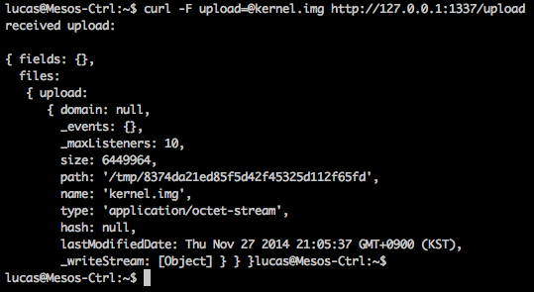
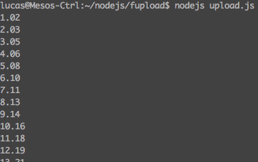
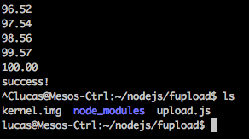
File Upload (4/4)
'<form action="/upload" enctype="multipart/form-data" method="post">'+
'<input type="text" name="title"><br>'+
'<input type="file" name="upload" multiple="multiple"><br>'+
'<input type="submit" value="Upload">'+
'</form>'
);
}).listen(1337);

Slide 19
Run a HTTP Web Server using node.js Express Module
Express is a node.js module for web application
Make a project folder
$ mkdir webserver
Create a package.json file in the project directory
$ cd webserver
$npm init -> Enter name, version, main and so on
Install express module and add dependency
$ npm install express --save
Check installed package list
$ npm ls or npm –g ls

Slide 20
Run a HTTP Web Server using node.js Express Module
Write a source code
$sudo vim app.js
var express = require('express')
var app = express()
app.get('/', function (req, res) {
res.send('Hello World')
})
app.get('/login', function (req, res) {
res.send('Please Login')
})
app.listen(3000, function () {
console.log('Example web server listening on port 3000!')
})

Slide 21
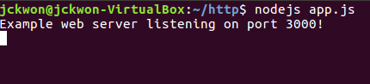
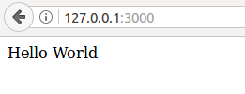
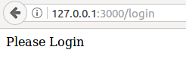
Run a HTTP Web Server using node.js Express Module
Run web server
$sudo nodejs app.js
Connect to your web server
http://{your_NUC_IP}:3000
http://{your_NUC_IP}:3000/login

Slide 22




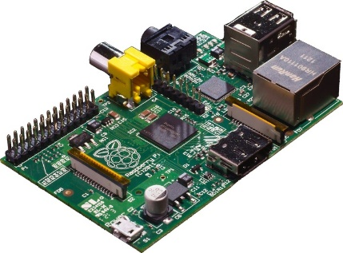

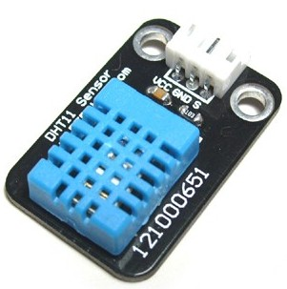
Architecture of WebApp

Slide 23
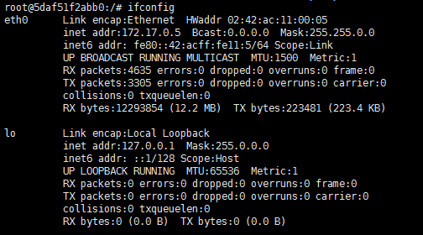
Create Docker Container for nodejs WebApp
Run a Docker Container
$ sudo docker run –it –-net=host --name=webapp ubuntu /bin/bash
On container
$ apt-get update
$ apt-get install net-tools
$ apt-get install iputils-ping

Slide 24


Install node.js in Docker Container
Install nodejs in Docker Container
$ apt-get install nodejs
$ (apt-get install nano)
Test
$ nano test.js (or vim nano.js)
$ nodejs test.js

Slide 25
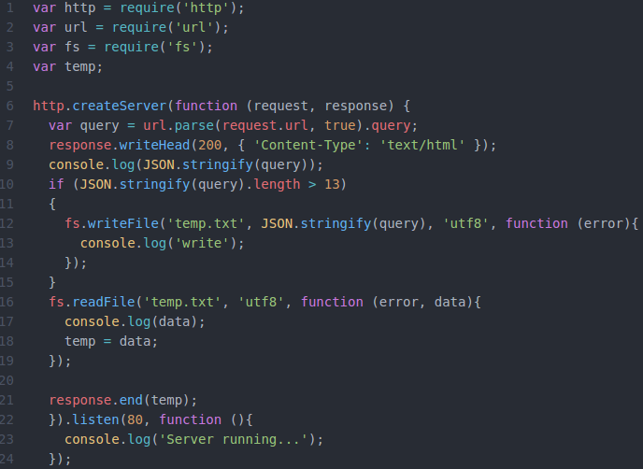
Write Server Application code
Write webapp.js code
$ sudo nano webapp.js (or sudo vim webapp.js)

Slide 26
Execute Server Application
Execute WebApp.js
- $ nodejs webapp.js
Open browser and go to
http://{IP_of_your_NUC}

Slide 27
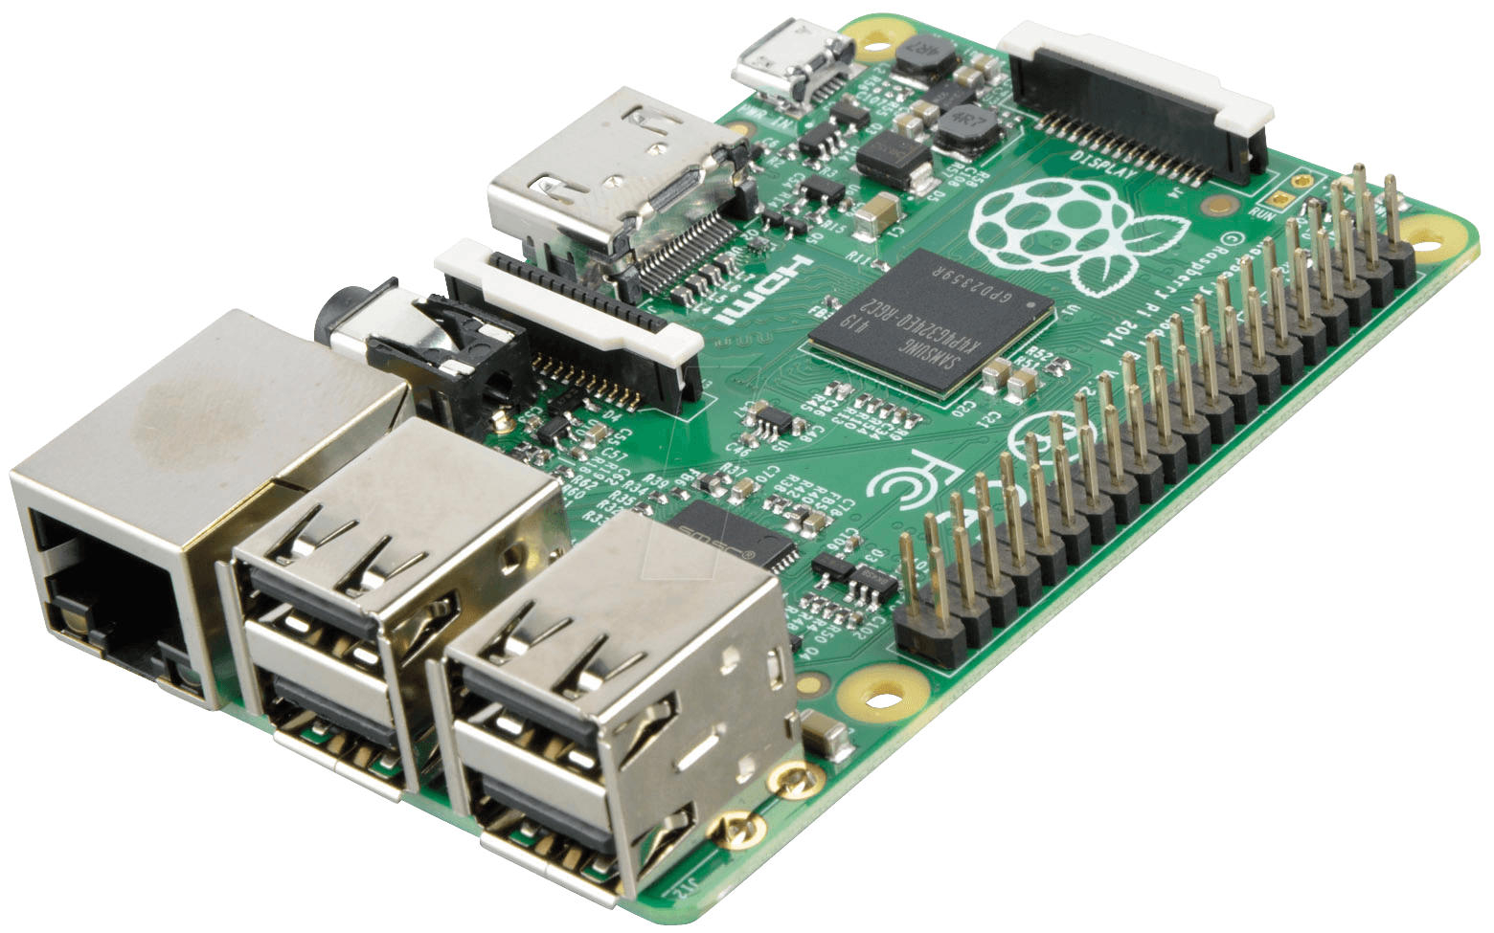
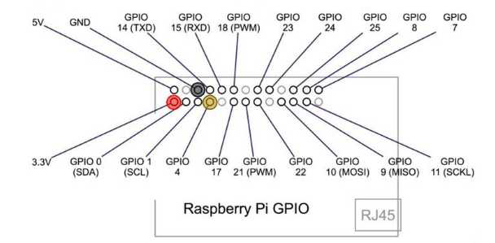
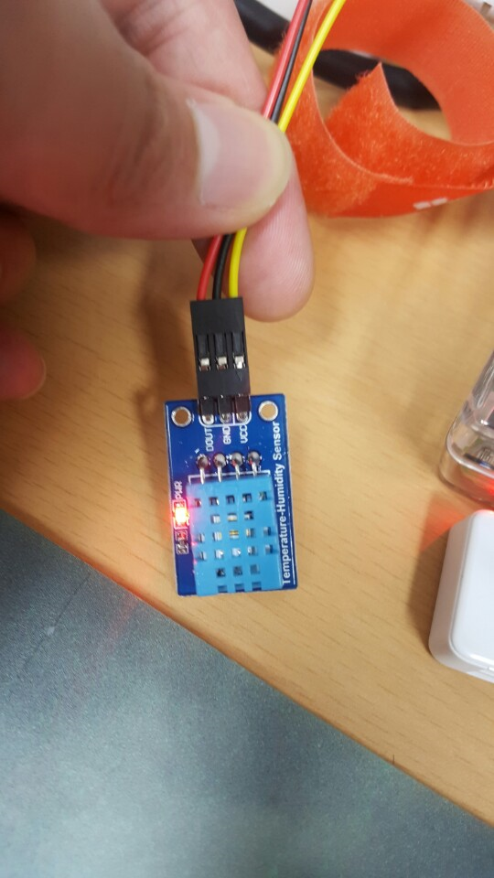
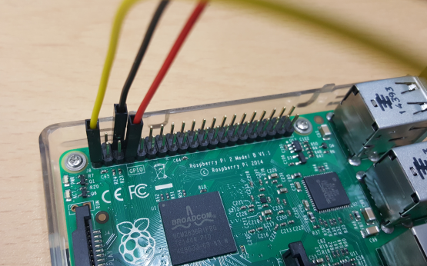
WebApp with RPi sensor
http://www.uugear.com/portfolio/dht11-humidity-temperature-sensor-module/

Slide 28
WebApp with RPi sensor
Install dependencies at RPi
$ sudo apt-get update
$ sudo apt-get install libpython2.7-dev python-numpy
$ sudo apt-get install RPi.GPIO
$ sudo apt-get install mercurial

Slide 29
WebApp with RPi sensor
Open Client Application source code
Copy source code from
https://github.com/2jungi/SmartX-Mini/blob/master/RPI_temp.py
$ sudo nano RPI_temp.py

Slide 30


Revise code for WebApp
Change IP address to <Your NUC’s IP>
sudo python RPI_temp.py
RPI_temp.py

Slide 31
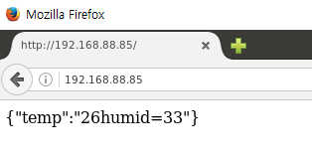
WebApp in Browser
At the Docker container in NUC
$ nodejs webapp.js
At the NUC
Open Web browser and go to http://<IP_of_NUC>
At the RPi
$ sudo python RPI_temp.py

Slide 32
References
http://nodejs.org/
http://expressjs.com
http://pyrasis.com/nodejs/nodejs-HOWTO
http://www.codediesel.com/nodejs/processing-file-uploads-in-node-js/
http://www.gliffy.com/publish/2752090/
http://kipid.tistory.com/entry/Learning-Nodejs
http://www.nodeclipse.org/ubuntu/linux/java/nodejs/2015/2015/07/09/Starting-with-Java-and-Node.js-development-on-Ubuntu-Linux.html

